Slide 1
Python Data Visualization
Notes:
Hi everyone. I am a teaching assistant for the Big Data Analytics course.
In today’s course, I’m going to introduce you how to use some simple methods to visualize data in Python.

Slide 2
Outline
Data Visualization
Jupyter
Word Cloud
Line Chart
Heat Map

Slide 3
Definition of Data Visualization
The definition of visualization: the conversion of invisible data into concrete graphics.
Visualizing data such as values, articles, or positioning information is called data visualization.
Data visualization usually uses statistical graphs, charts or other tools.
We can use dots, lines or bars to encode data in order to visually display quantitative information.

Slide 4
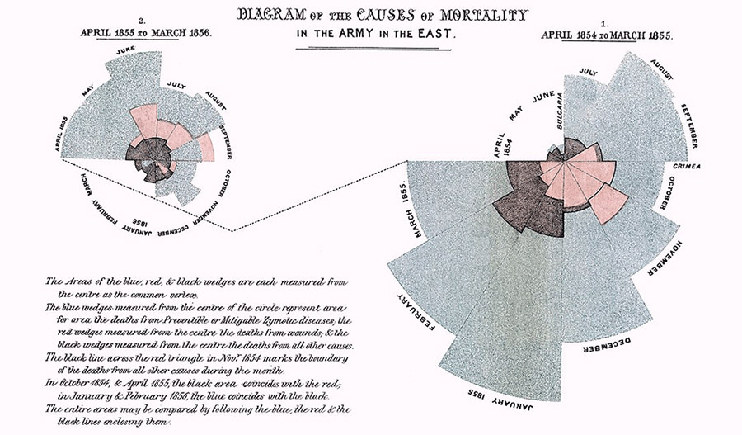
Example of Data Visualization
http://blog.infographics.tw/2016/02/nightingale-rose-chart/
Notes:
https://buzzorange.com/citiorange/2017/01/06/florence-nightingale-wind-rose-charts/

Slide 5
Function of Data Visualization
Function of Data Visualization
Overview
Discover
Convey

Slide 6
Jupyter Notebook
Jupyter Notebook is an opensource integrated development environment built on website.
Allow data scientists to write programs, display programs, and visualize output.
Jupyter Notebook will display the execution results below the code, so it is very suitable for beginners to practice data visualization.
Notes:
Jupyter Notebook is an open source integrated development environment built on web applications.
Allowing data science teams to write programs, display programs, and visualize output as if they were computing in a notebook.

Slide 7
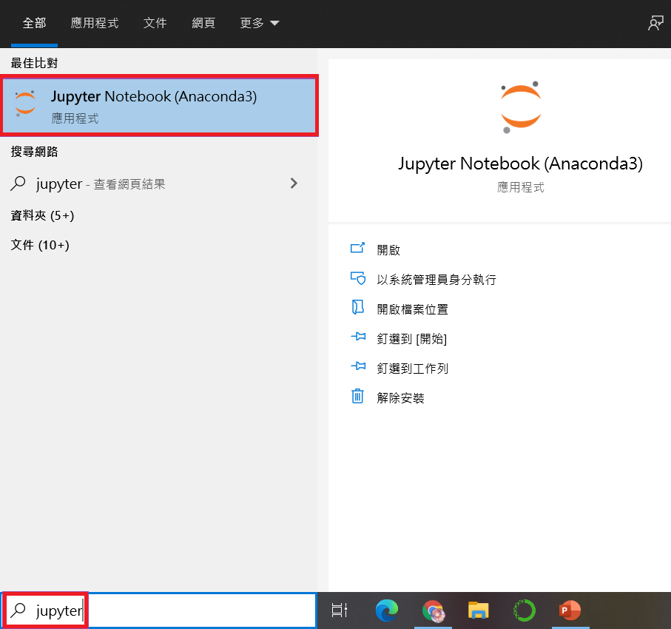
Open Jupyter Notebook
Search jupyter on windows
Click Jupyter Notebook to enter your local host in browser.
Notes:
First we will teach you how to open jupyter notebook.
You can Search jupyter on windows, and the search result of Jupyter Notebook will pop up and click it to enter your local host in browser.

Slide 8
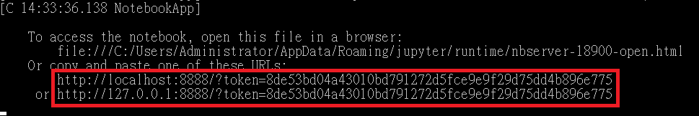
Change Browser
After clicking Jupyter Notebook, the default browser will be launched. If you want to change the browser, you can copy the URL in the Prompt of Jupyter Notebook (in the red box of the picture), and then paste the URL into the browser you want to use.

Slide 9
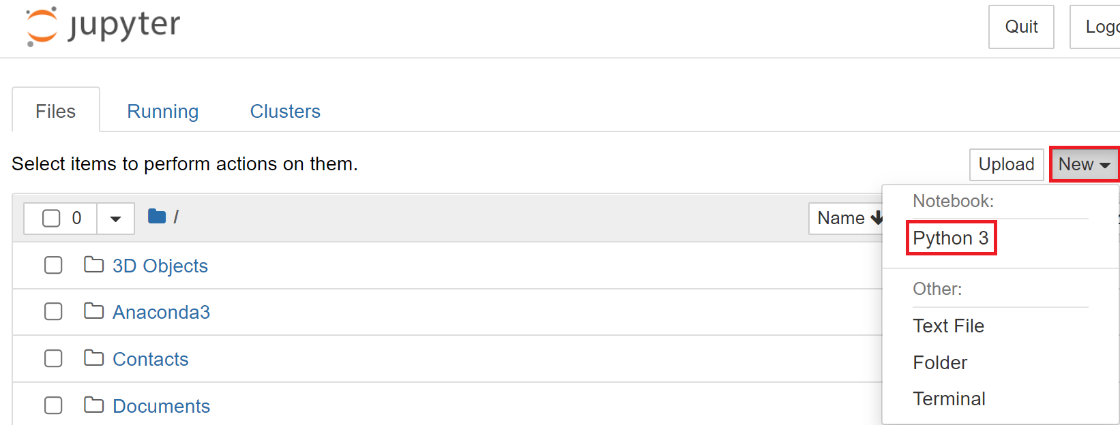
Create a New Notebook
Select "Python 3" from the "New" drop-down.
Notes:
Select "Python 3" from the "New" drop-down menu in the upper right corner
And you will successfully create a new notebook file.

Slide 10
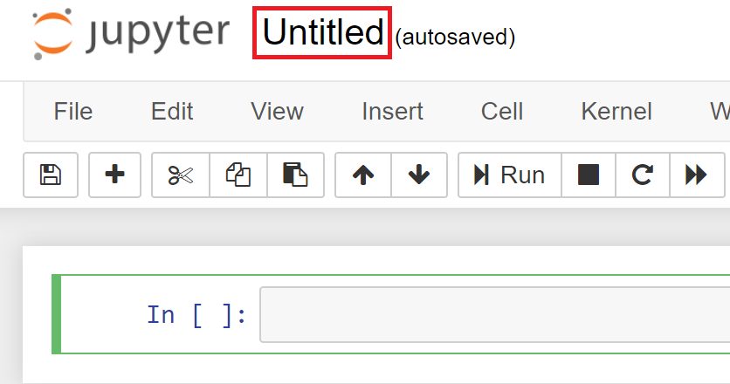
Change File Name
Click "Untitled" on the right side of the Jupyter logo and enter your new file name, click "Rename" button to confirm that the file name update is complete.
Notes:
You can change file name by clicking "Untitled" on the right side of the Jupyter logo and enter your new file name,
click "Rename" button to confirm that the file name update is complete.

Slide 11
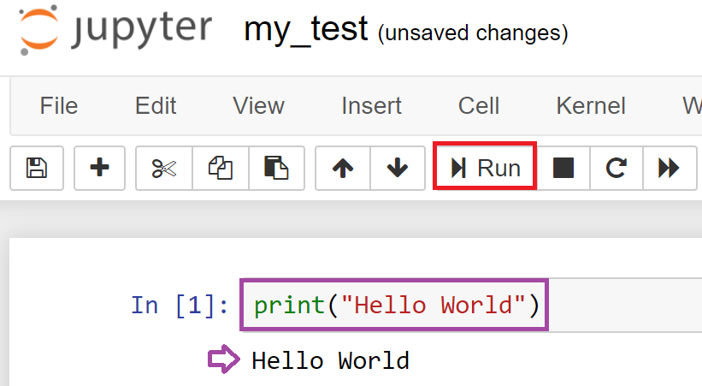
Program Execution
Please enter print("Hello World") in the cell.
Click "Run" to execute the program, or you can directly press "Shift" + "Enter" to execute.
Notes:
Now we are going to run the program.
Please enter print("Hello World") in the cell.
Click "Run" to execute the program, or you can directly press "Shift" + "Enter" to execute.

Slide 12
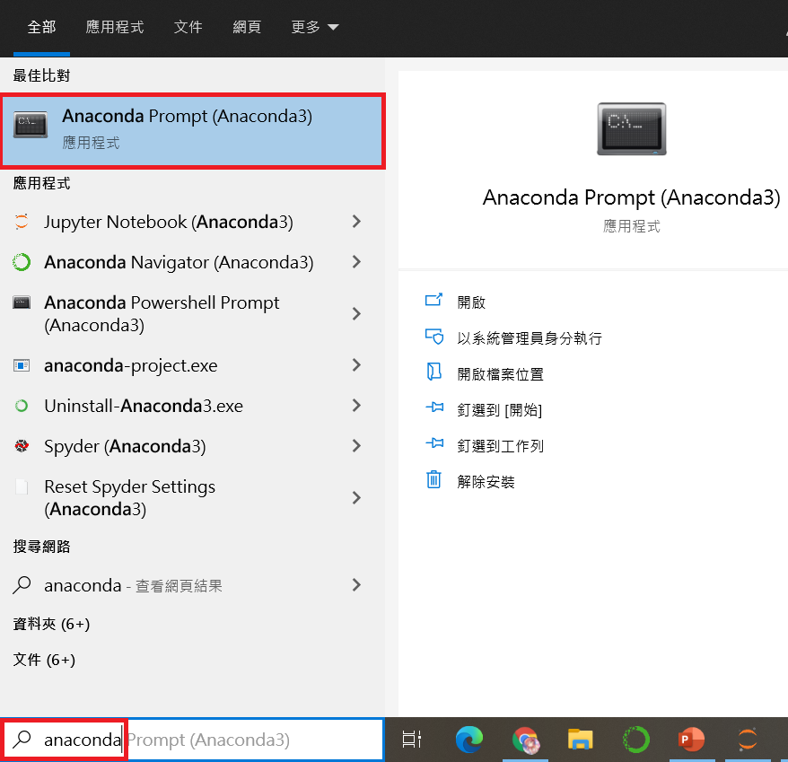
Install Library
Assuming an error occurs, please confirm whether the necessary library is installed.
Open Anaconda Prompt to install the library.
Notes:
Assuming an error occurs when running the sample file, please confirm whether the necessary library is installed.
If it has not been installed, please start Anaconda Prompt to install it.

Slide 13
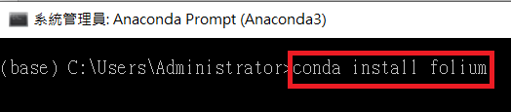
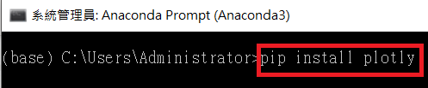
Install Packages
Enter conda install (library name) to install the necessary packages.
If you can't install it with the conda command, change it to pip install (library name).
Notes:
There are two ways to install packages.

Slide 14
Word Cloud
Use crawler tools to crawl PTT website and draw it into a word cloud
Notes:
After finishing the basic introduction in jupyter, we are going to enter the data visualization part.
We will teach everyone how to use crawler tools to crawl PTT website and draw it into a word cloud

Slide 15
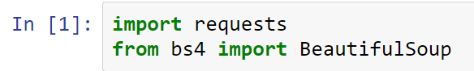
Crawler Library
1. requests is used to send HTTP requests and responses.
2. BeautifulSoup is used to analyze and crawl elements in HTML.
Notes:
First, let's introduce the two libraries needed by web crawlers.

Slide 16
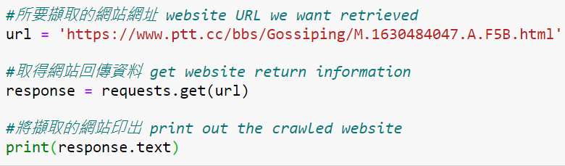
Get Website Source Code
Use get() function to obtain the source code of the website and print out the crawled data in Jupyter Notebook.
Notes:
After setting a variable url to store the website we want retrieved,
we will then use the get() function to obtain the source code of the website and print out the crawled data in Jupyter Notebook.

Slide 17
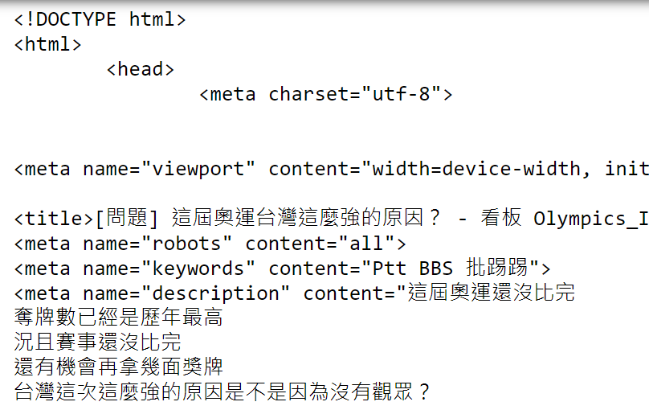
Print Website Data
The printed content will probably look like this:

Slide 18
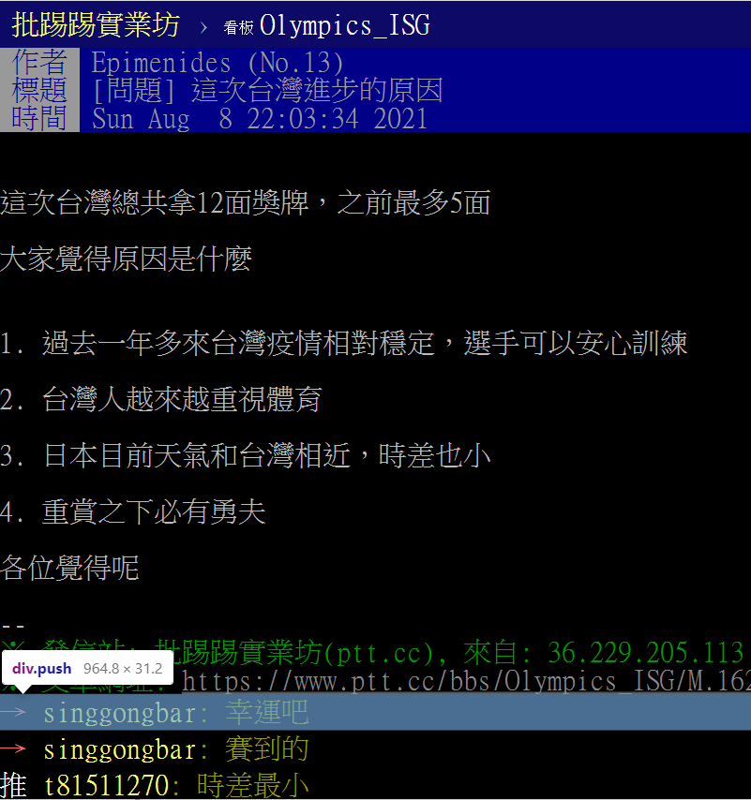
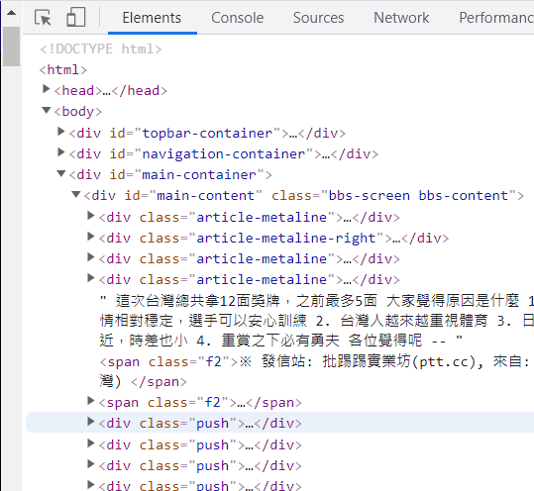
Search PTT Pushes
We can press F12 (Developer Tools) to observe where PTT’s pushes will be placed.
Notes:
Our example needs to crawl out all the pushes in an article on PTT.
Since we need to crawl the PTT webpage later, we need to know the structure of the PTT website first.
We can press (F12, Developer Tools) to observe where ptt’s pushes will be placed.
We find that the pushes will be placed in the div tag with class = "push“.

Slide 19
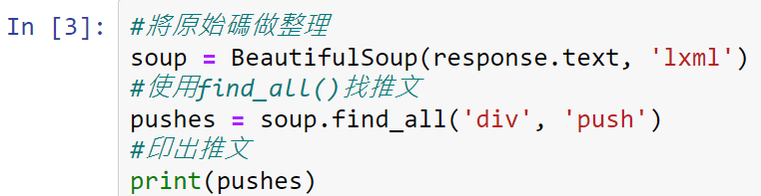
Use find_all() to Find Pushes
We find that the pushes will be placed in the div tag with class = “push“.
Use the find_all() function to operate BeautifulSoup to find all the pushes in <div> tag.
Notes:
Here we will use the find_all() function to operate BeautifulSoup to find all the pushes in <div> tag.

Slide 20
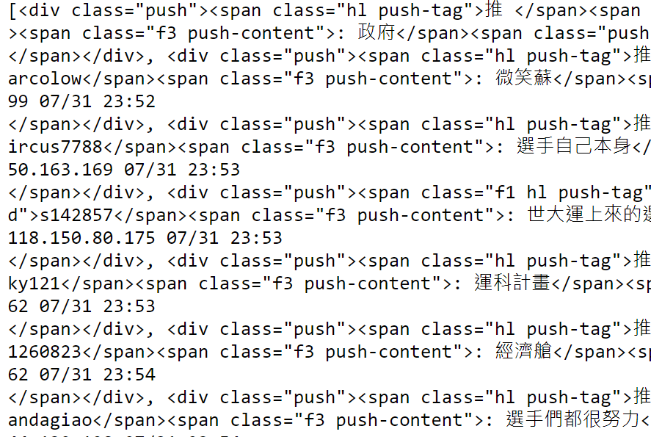
Print Out All Pushes
Print out all the contents in the div tag with class = “push” as shown below.
Notes:
Print out all the contents in the div tag with class = “push” as shown below.

Slide 21
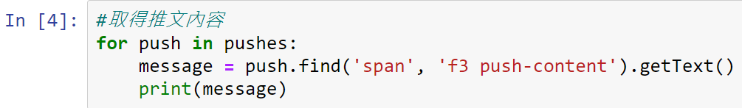
Retrieve Pushes
Use the find() function to retrieve the pushes, and we find that the pushes exist in the tag name <span>, <class ="f3 push-content">.
getText() function provides us to get text and catalog management.
Notes:
Next, we need to retrieve the pushes,
We can use the find() function to retrieve the pushes, and we find that the pushes exist in the tag which name is <span>, <class ="f3 push-content">.
find() function helps to find the index of occurrence of the substring in the given string. It will return -1 if the substring is not present.

Slide 22
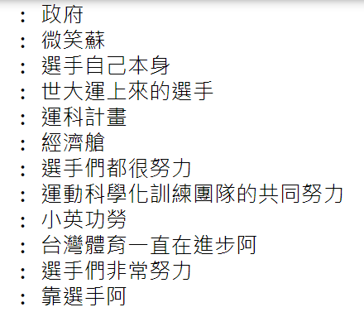
Retrieve Pushes (Cont’d)
The printed results are as shown below.

Slide 23
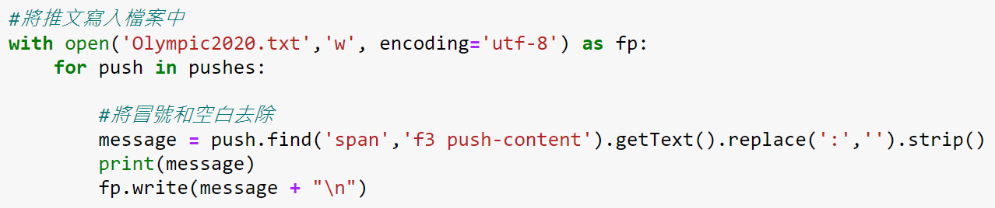
Remove Colons
Use replace() function to remove the colon.
Use strip() function to remove the spaces.
Use write() to write the sorted data into the file.
Notes:
If we want to write a push without a colon in a file named Olympic2020.txt, we can use the replace() function to remove the colon, then use the strip() function to remove the spaces, and finally use write() to write the sorted data into the file.
Find_all returns all matched results, which is different from find (find only returns the first result found) #Find_all 返回所有匹配到的结果，区别于find（find只返回查找到的第一个结果）

Slide 24
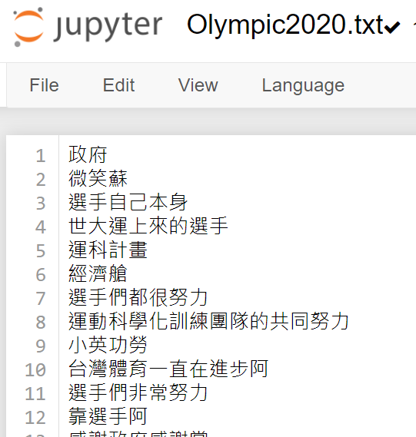
Remove Colons (Cont’d)
The pushes in PTT website were successfully saved without colons to Olympic2020.txt.

Slide 25
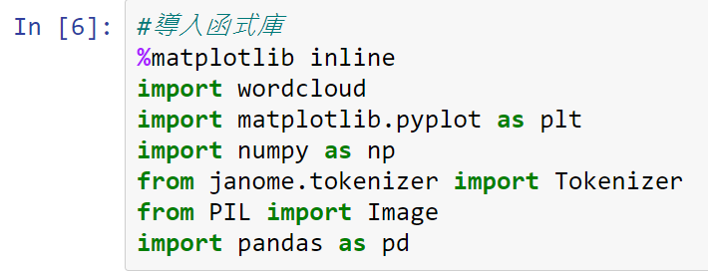
Start Drawing Word Cloud
The wordcloud can recognize a string of blank characters as a single word, and then make it as word cloud.
Notes:
To draw a word cloud, we will use the wordcloud library. The wordcloud can recognize a string of blank characters as a single word, and then make it as word cloud.
The picture below is the library needed to draw a word cloud.

Slide 26
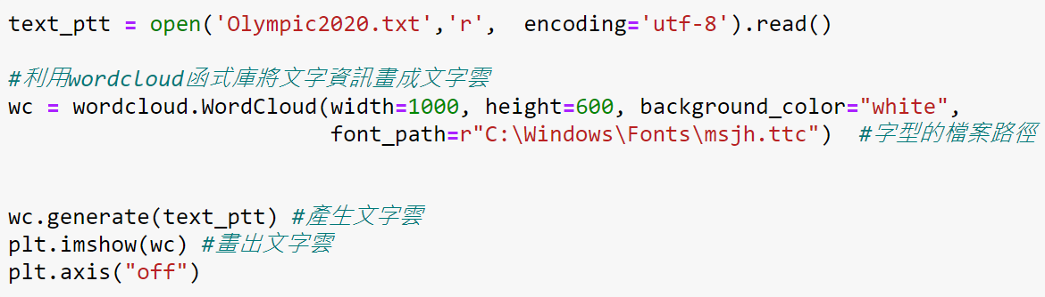
WordCloud Function
The parameter width in WordCloud can set the width, height can set the height, background_color can set the background color of the word cloud, font_path can specify the path of the font file.
generate() function will help us generate word cloud.

Slide 27

WordCloud Function (Cont’d)
Word cloud output:
Notes:
The result after the above program is executed is as shown in the figure below.

Slide 28

Change Mask Image
First, we need to prepare a silhouette picture.
You can download pictures from the following website: https://www.flaticon.com/
Please note that the image format must be png.
In the following example, we use the heart image (named like.png) as a word cloud mask.
Notes:
Next we will introduce how to change the mask image.

Slide 29
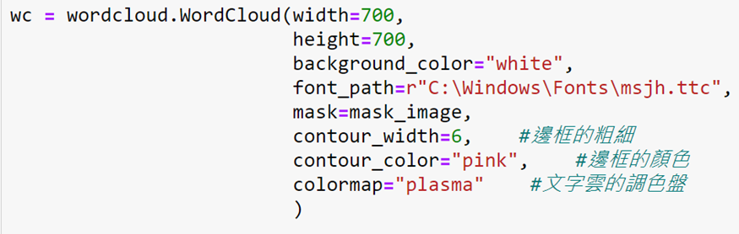
Change Mask Image (Cont’d)
The parameter mask in WordCloud can specify a mask image.
Use the parameter contour_width to set the thickness of the border, and the parameter countou_color to determine the border color.
colormap can sets the color of text in the word cloud.
Notes:
The parameter mask in WordCloud can specify a mask image.
In order to see the shape of the mask clearly, we can add a border to the mask. At this time, we use the parameter contour_width to set the thickness of the border, and the parameter countou_color to determine the border color.
colormap can sets the color of text in the word cloud.

Slide 30
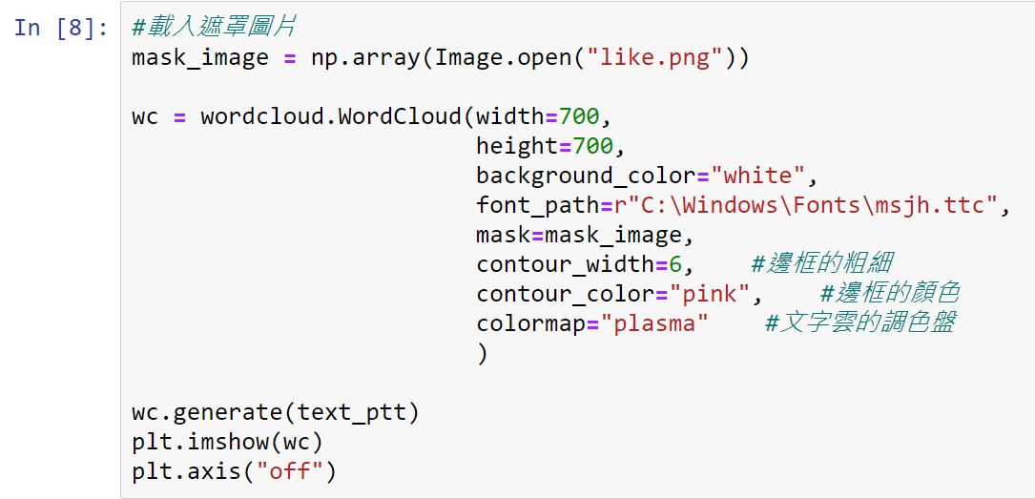
Change Mask Image (Cont’d)
Full steps about changing the mask image.

Slide 31

Change Mask Image (Cont’d)
Output after changing the mask image:

Slide 32
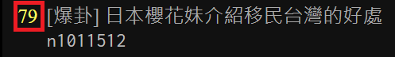
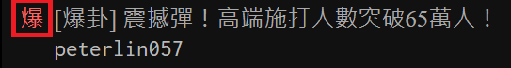
Exercise 1
Please find an article you are interested in on PTT and the number of pushes are greater than 50 to draw a word cloud.
Change the mask of word cloud above to a circle.
Notes:
Now we have our first exercise.

Slide 33
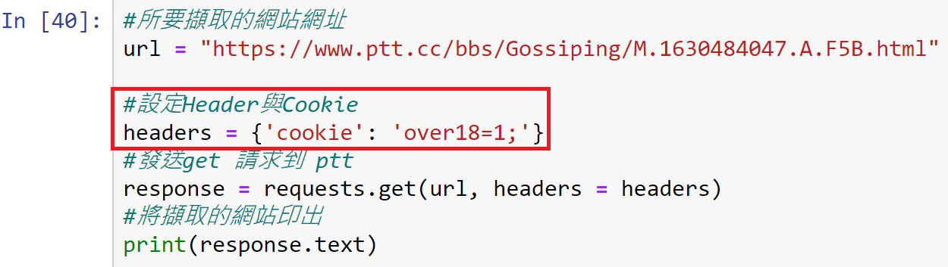
Hint
If the URL you enter has R-18 restrictions, you can use the following code to crawl pushes.

Slide 34


Exercise1 Example

Slide 35
Line Chart
Use weather data on internet to draw temperature line chart
Notes:
Next, we will introduce how to crawl the weather data on the Internet and draw it to line chart.

Slide 36
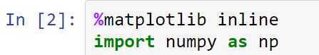
Numpy
Numpy is a basic function library required for scientific operations using Python, including array operations that we will use later..
You can call the Numpy function as np.
Load Numpy with import numpy as np.
Notes:
First, let's introduce the library needed to draw the line chart.
Numpy is a basic function library required for scientific operations using Python, including array operations that we will use later..
Generally speaking, we will call the Numpy function as np. We can load Numpy with import numpy as np.

Slide 37
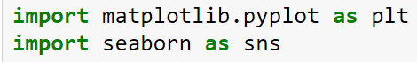
Matplotlib & Seaborn
Matplotlib is a classic library that uses Python visualization data, which can be used to display charts in Python development environments such as Jupyter Notebook.
Seaborn is a Python visualization data library based on matplotlib, which can make the visualization statistics more beautiful.

Slide 38
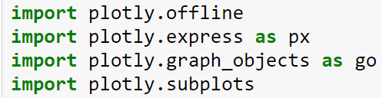
Plotly
Plotly is a library that can draw dynamic charts, and can also use preset values to beautify the chart.

Slide 39
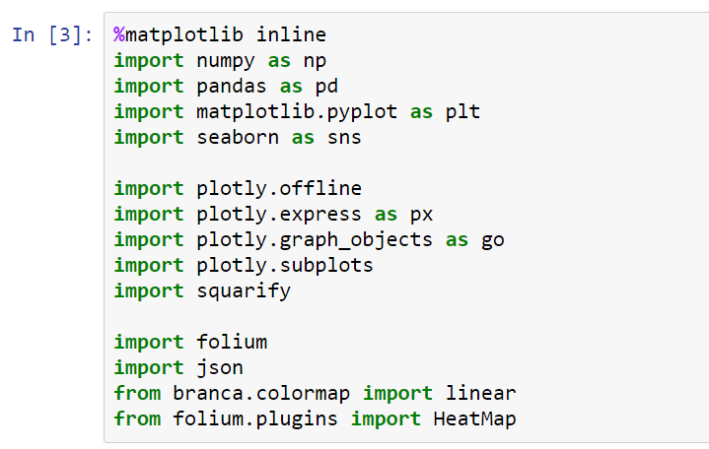
Import Full Library
Notes:
The picture below is the library needed to draw a line chart.
If you want to import full library please check this page.

Slide 40
Get Weather Data from Website
We provide you with the following two methods to obtain weather data from the website:
Click the download button on the website, download the file to your computer, and then upload the file to jupyter notebook.
Use web crawlers to obtain website information and data.
URL link: http://e-service.cwb.gov.tw/HistoryDataQuery/MonthDataController.do?command=viewMain&station=466920&stname=%25E8%2587%25BA%25E5%258C%2597&datepicker=2021-09
Notes:
In order to draw a line chart, we first need to obtain weather data.
We provide you with the following two methods to obtain weather data from the website:
You can use the URL we provide for implementation.

Slide 41
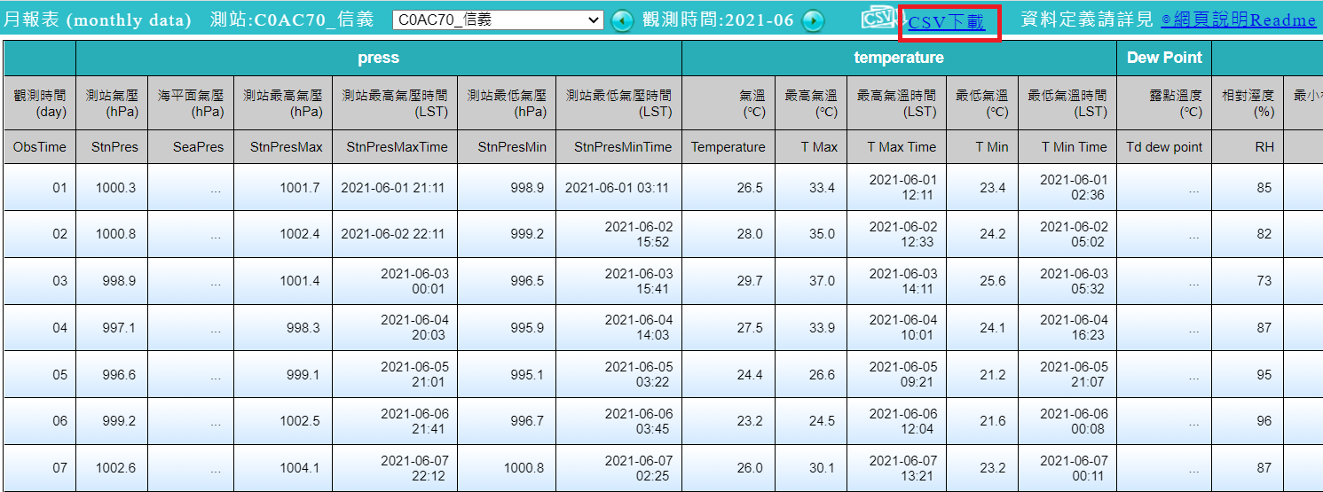
Method 1: Download File
You can use the URL we provided on the previous page to link to the website and download the data.
Notes:
Click the red box in this picture to download csv file.

Slide 42
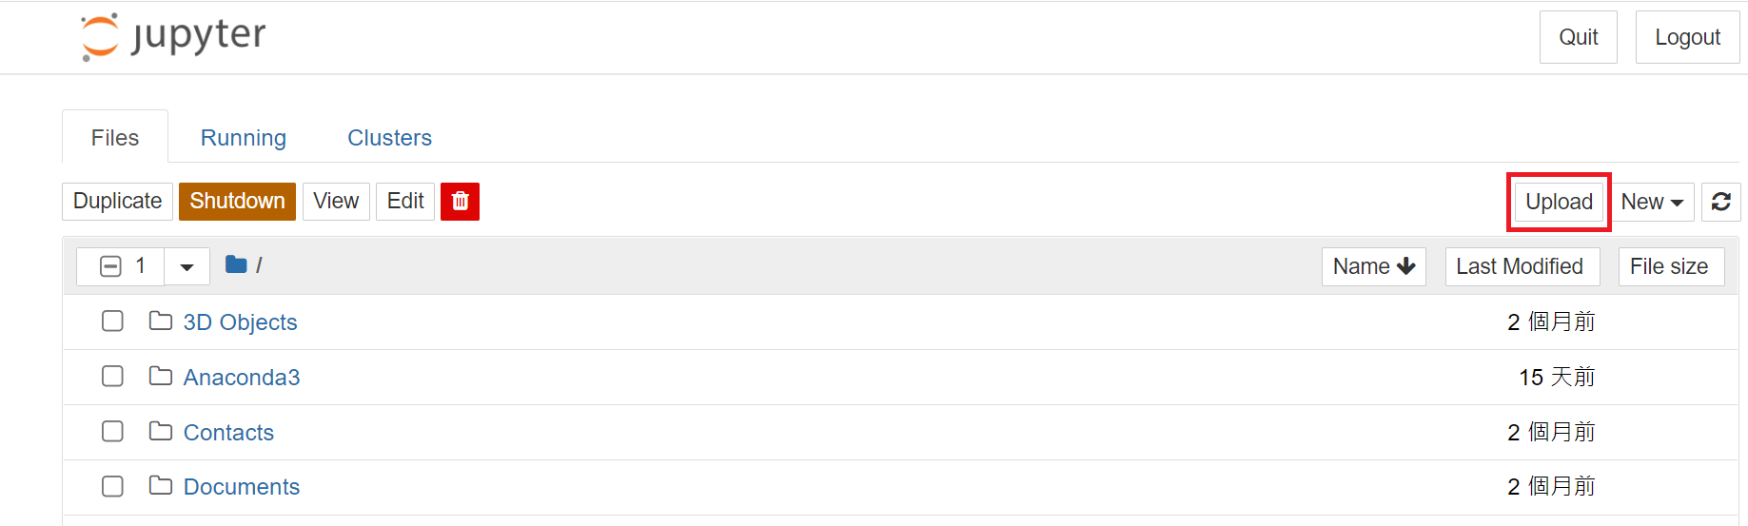
Method 1: Upload File to Jupyter
Upload the downloaded file to Jupyter Notebook.
Notes:
Click the red box in this picture to upload csv file.

Slide 43
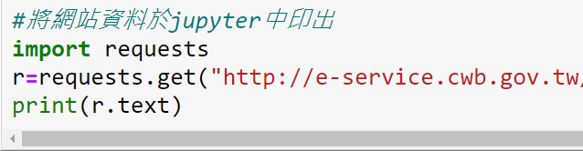
Method 2: Web Crawlers
Print out the website information in jupyter to determine what data we need.
Notes:
Second method is web crawlers.
First of all, we need to print out the website information in jupyter to determine what data we need.

Slide 44
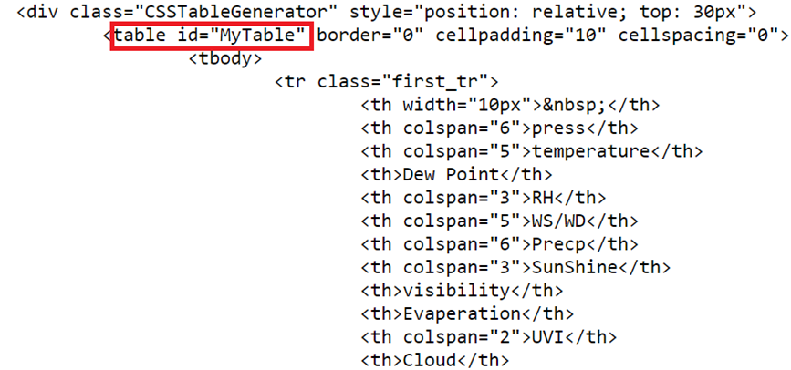
Method 2: Find Table ID
After executing the program described on the previous page, we can show the details of the webpage in Jupyter Notebook.
The data we look for is in <table> and the tag of table id is “Mytable”.
Notes:
The picture below shows the details of the webpage.
The data we look for is in <table> tag and the table tag’s id is “Mytable”.

Slide 45
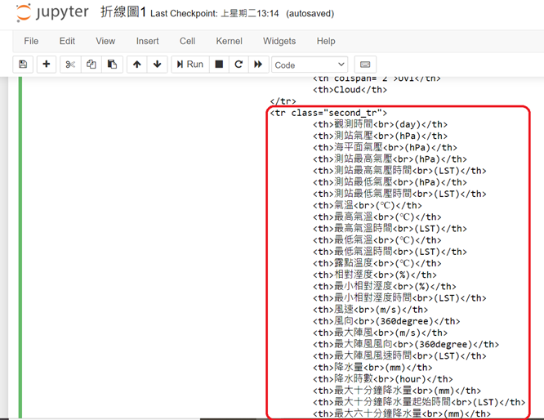
Method 2: Find the Data We Need
<table> is used to wrap the structure and content of the entire table, <tr> (table row) is used to define how many rows the table has, and <tr> contains <td> (table data) to define how many cloumns the table has. <th> (table header) defines a header cell in an HTML table.
Find the data we need, and we can recognize that they are all wrapped in <tr>, <td> and <th> label.
Notes:
<table> is used to wrap the structure and content of the entire table, <tr> (table row) is used to define how many rows the table has (row), and <tr> contains <td> (table data) to define how many cloumns the table has. <th> (table header) defines a header cell in an HTML table.
<table> table, <tr> table row, <td> table data column, <th> table header.

Slide 46
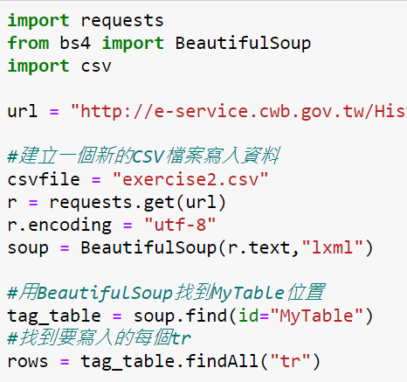
Method 2: Web Crawlers Detail
url = “http://e-service.cwb.gov.tw/HistoryDataQuery/MonthDataController.do?command=viewMain&station=C0AC70&stname=%25E4%25BF%25A1%25E7%25BE%25A9&datepicker=2021-06”
Notes:
First we need to create a new CSV file to write data. Search table ID=MyTable with BeautifulSoup . Find each <tr> to be written.

Slide 47
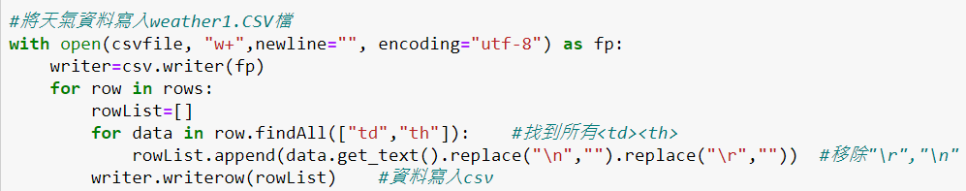
Method 2: Crawl the Data We Need
The append() function is used to add new objects at the end of the list.
writerows() write all the elements in rows into the csv file, and format it according to the current variables.
Notes:
So we open csv file and write new data in.
We use the for loop to write all the data about <td><th> which are in <tr> label into the csv file.

Slide 48
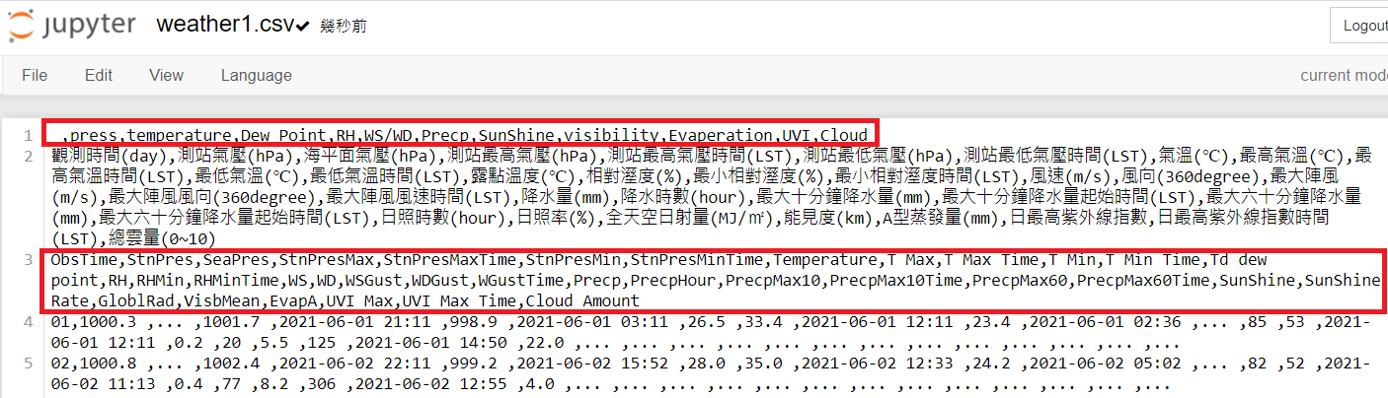
Method 2: Delete the Data
After performing the above steps we need to delete the data that may cause errors (the red box in the figure below).
Notes:
After performing the above steps we need to delete the data that may cause errors .

Slide 49
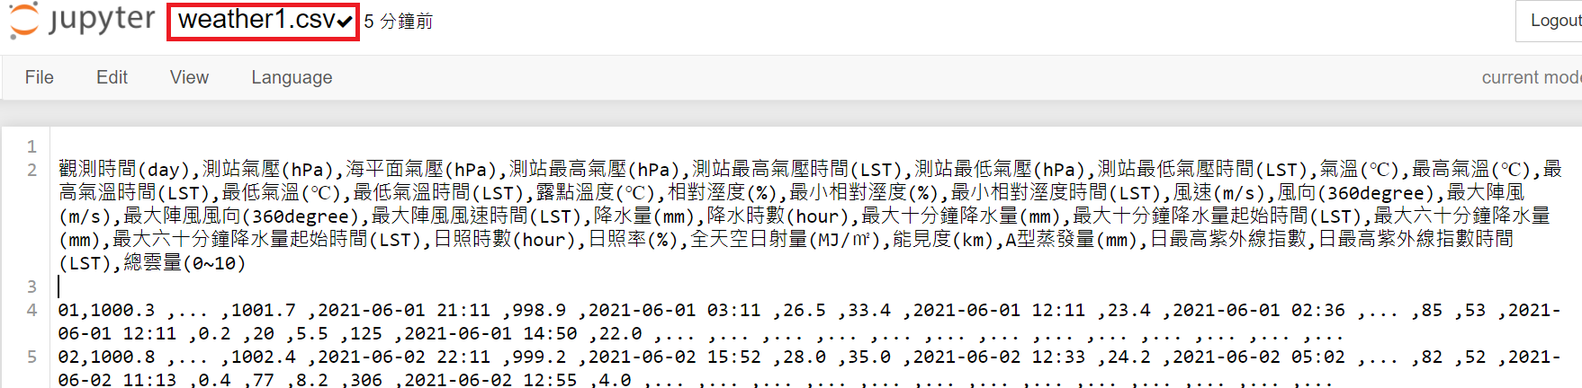
Method 2: Web Crawler Execution Results
Please confirm that the web page data has been written in CSV file successfully.
Notes:
After we delete please confirm that the web page data has been written in CSV file successfully.

Slide 50
Load weather1.csv
Load the “觀測時間(day)” column of weather1.csv with date type.
Assign the column list loaded in datetime format representing the time to the parameter parse_dates at this time.
Notes:
After completing the data crawling, we will next introduce how to draw the data into a line chart.
First, load the “觀測時間(day)” column of weather1.csv with date type. “觀測時間(day)" is the key of weather1.csv.
And assign the column list loaded in datetime format representing the time to the parameter parse_dates at this time.
If this step is not performed, the polyline cannot be drawn when charting.

Slide 51
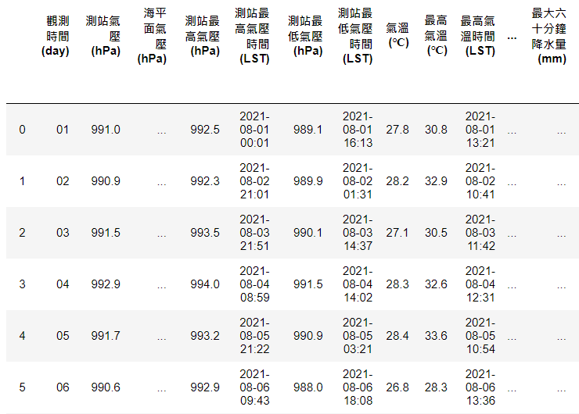
Load weather1.csv (Cont’d)
This picture show the result after performing the above steps.
Notes:
This picture show the result after performing the above steps.

Slide 52
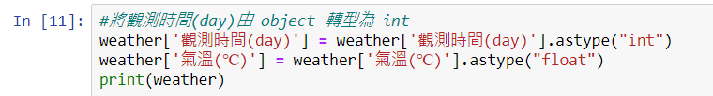
Data Type Conversion
The data type crawled by the web crawler may be object, which may cause the problem that the line chart cannot be drawn. We need to manually force it to int or float data type.
Notes:
The data type captured by the web crawler may be object, which may cause the problem that the line chart cannot be drawn.
At this time, we need to manually force it to int or float data type.
# Convert the observation time (day) from object to int

Slide 53
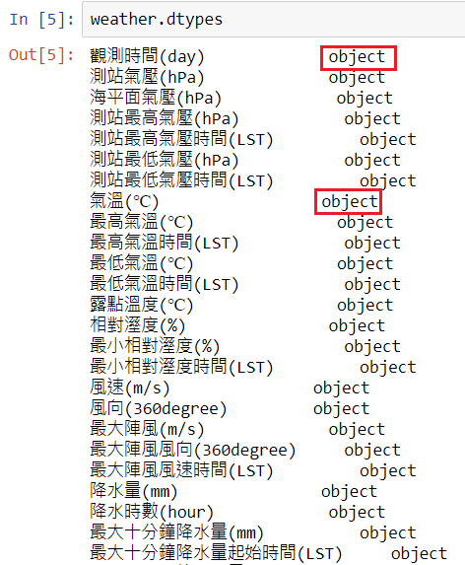
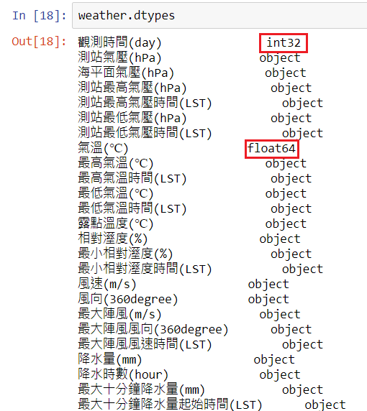
Data Type Conversion (Cont’d)
Notes:
From the figure above, we can see that the variables have been successfully transformed into int and float data types.

Slide 54
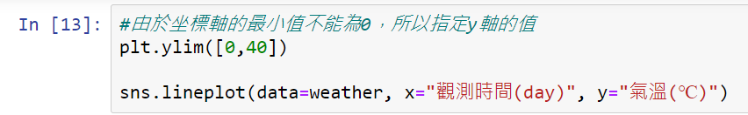
Draw a Line Chart
Line charts can be drawn using the sns.lineplot function.
Specify the column of the horizontal axis in the parameter x, and specify the vertical axis field in the parameter y.
Notes:
Next we will introduce how to draw a line chart.
#Because the minimum value of the horizontal axis cannot be 0 (our horizontal axis is “觀測時間(day)“), so we specify the value of the y axis.

Slide 55
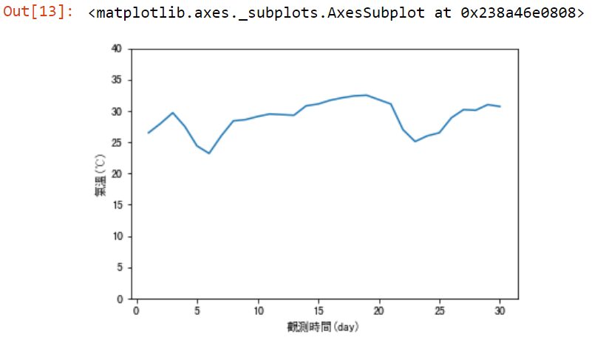
Draw a Line Chart (Cont’d)
The output after performing the previous page.
Notes:
The output after performing the previous steps.

Slide 56
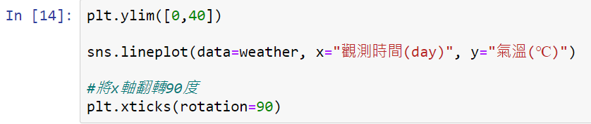
Straighten the Horizontal Axis
If the string of the horizontal axis is too long, it may cause the scale to be covered, so we use the xticks() function to make the scale of the horizontal axis become straight.
Notes:
If the string of the horizontal axis is too long, it may cause the scale to be covered, so we use the setting of plt.xticks(rotation=90) to make the scale of the horizontal axis become straight.

Slide 57
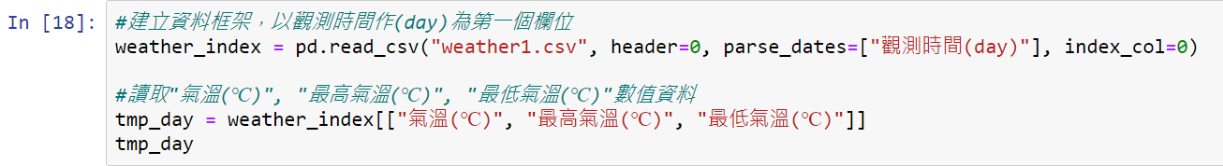
Draw Multiple Line Charts
The first step is to create a data frame. "觀測時間(day) " is the first column in weather1.csv, so when we use the pd.read_csv function to load the CSV file, we specify index_col as 0 (that is, "觀測時間(day) " as the first column), so we can create a data frame with date.
Notes:
Then we introduce how to draw multiple line charts.

Slide 58
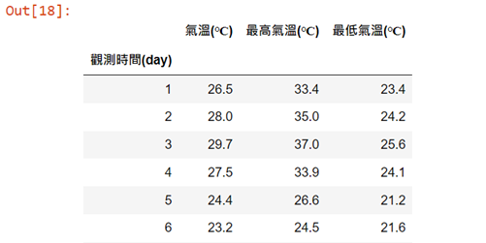
Draw Multiple Line Charts (Cont’d)
Data frame output:
Notes:
You can see that “觀測時間(day)” become the first column and is followed by “氣溫”、”最高氣溫”、”最低氣溫” columns.

Slide 59
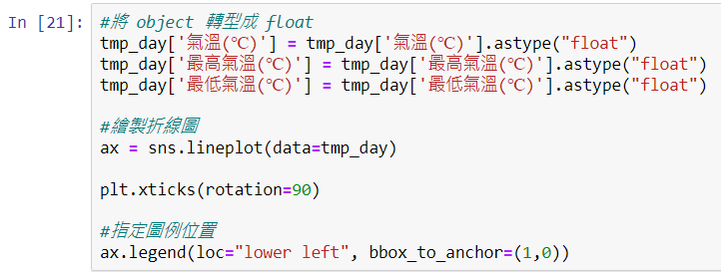
Draw Multiple Line Charts (Cont’d)
If you want to display the legend of the chart somewhere, you can use the loc (location) parameter of the legend function to specify legend position.
Notes:
#Convert object to float #Use the sns.lineplot function to draw line chart

Slide 60

Draw Multiple Line Charts (Cont’d)
There are three different types of line charts, so the next step is setting line chart to the same type.
Notes:
You can see that there are three different types of line charts, so the next step is setting line chart to the same type.

Slide 61

Set Line Chart to Same Type
Put the attributes to be adjusted in the same column and adjust the format of the data (in this program is to be “氣溫種類”).
rename_axis() functionis used to rename the name of index.
reset_index() takes the current index, and places it in column.
We can use the rename() function to change the column name to "溫度(℃)".

Slide 62

Set Line Chart to Same Type (Cont’d)
Output after using the rename function:

Slide 63

Set Line Chart to Same Type (Cont’d)
Use the parameter hue to specify the column to be drawn in different colors. In this example we specify “氣溫種類” to draw a line chart in different colors.
Notes:
In this example we specify “氣溫種類” to draw in different colors.

Slide 64

Set Line Chart to Same Type (Cont’d)
Compared to the previous folded line diagrams, the same types are now available, but the colors remain different for easy viewing.

Slide 65

Highlight One of Line Charts
Use the len function and the unique function to calculate the number of categories of "氣溫種類“.
Use the parameter palette of the sns.lineplot function to change the color of the palette.
Notes:
Next we will introduce how to highlight one of the line charts.

Slide 66

Highlight One of Line Charts (Cont’d)
Notes:
This picture is the whole steps of highlighting one of the line charts.

Slide 67

Highlight One of Line Charts (Cont’d)
The output after performing the previous page. You can see that “氣溫(℃)" is highlighted in red.
Notes:
You can see that “氣溫" is highlighted in red.

Slide 68

Use plotly to Draw a Line Chart
If you use plotly to draw a line chart, the code can be very streamlined and the data can be displayed dynamically, for example: when the mouse is moved into the chart, the value at each time point will be displayed.
We can use the px.line function to draw a line chart.
Notes:
Next, I will introduce another method of drawing a line chart, by using the plotly function.

Slide 69

Use plotly to Draw a Line Chart (Cont’d)
The line chart produced by plotly.

Slide 70

Use plotly to Draw Multiple Line Charts
If you want to use plotly to draw multiple line charts, you can define each line chart first, and then gather these line charts in a single chart.
First specify lines in the parameter mode of the go.Scatter function to create line chart data of different temperature types.
X axis is “觀測時間(day)" ,and Y axis are different types of temperature.
Notes:
X axis is “觀測時間" ,and Y axis are different types of temperature.

Slide 71

Use plotly to Draw Multiple Line Charts (Cont’d)
To integrate these line graphs into a single chart, the parameter data of the go.Figure function can be used to specify the line graph data list of different types of temperature.

Slide 72

Use plotly to Draw Multiple Line Charts (Cont’d)
tmp_ave, tmp_high, tmp_low data output:

Slide 73

Use plotly to Draw Multiple Line Charts (Cont’d)
Multiple line charts output drawing by plotly:

Slide 74

Smooth the Line Chart
Use the scipy library to smooth the curve of the line chart.
The linspace function in Numpy can spread points evenly within a certain range.
For example, if we want to generate 10 points between 1 and 5, our program can be written as follows.
Notes:
Now we will teach you how to smooth the line chart.

Slide 75

Smooth the Line Chart (Cont’d)
First use make_interp_spline() to determine the coefficients of the spline to draw a smooth spline.
Optional parameter num is the number of samples to generate within the range from start to stop.
We take 300 equally spaced samples between min and max values along the X-axis to plot the curve.

Slide 76

Smooth the Line Chart (Cont’d)
The scatter chart can be drawn with the scatter() function, the parameter x can specify the column of the horizontal axis, and the parameter y can specify the column of the vertical axis.
The parameter color can specify the color of the dots, and the parameter alpha can specify a value between 0 and 1. Make the color of the dots transparent.

Slide 77

Smooth the Line Chart (Cont’d)
Notes:
This picture is the whole steps of smoothing the line chart .

Slide 78

Smooth the Line Chart (Cont’d)
The output after smoothing the line chart .

Slide 79

Smooth the Line Chart (Cont’d)
Establish x-axis and y-axis matrix as "觀測時間(day) and "氣溫(℃)“ then smooth the data.

Slide 80

Smooth the Line Chart (Cont’d)
Use the title() function to add a title to the line chart.
Use the x.label(), y.label() functions to add labels to the x and y axes.

Slide 81

Smooth the Line Chart (Cont’d)
Notes:
This picture is the whole steps of smoothing the line chart.

Slide 82

Smooth the Line Chart (Cont’d)
The output after performing the previous page.

Slide 83

Chinese Display Problem
If you have encountered an abnormal display of Chinese, please go to the URL provided by us, and follow the instructions of the website to solve the abnormal display.
URL link: https://www.getit01.com/p20190120250957403/

Slide 84
Exercise 2
Please get the weather data for any month and any region from the website we provide. Draw the "氣溫(℃)", "最高氣溫(℃)", and "最低氣溫(℃)" as a line chart and highlight the "最高氣溫(℃)".
Draw "氣溫(℃)", "最高氣溫(℃)", and "最低氣溫(℃)" as a line chart and smooth it.
URL link: http://e-service.cwb.gov.tw/HistoryDataQuery/MonthDataController.do?command=viewMain&station=C0AC70&stname=%25E4%25BF%25A1%25E7%25BE%25A9&datepicker=2021-09
Notes:
Now we have second exercise for you.

Slide 85


Exercise2 Example

Slide 86
Heat Map
Use covid-19 related data to draw heat maps
Notes:
Then we are going to teach you how to draw a heat map.

Slide 87

Draw a Heat Map
Load the library will use.

Slide 88

Draw a Map of the Administrative Regions of the United States
We use the parameter location of the folium.map function to specify the latitude and longitude.
zoom_start is the zoom level of the map. The smaller the value, the larger the coverage of the map. On the contrary, the larger the value, the smaller the coverage of the map.
Notes:
First of all, we have to define the base map.
We use the parameter location of the folium.map function to specify the latitude and longitude of the map, and the parameter zoom_start is the zoom level of the map. The smaller the value, the larger the coverage of the map. On the contrary, the larger the value, the smaller the coverage of the map.

Slide 89

Draw a Map of the Administrative Regions of the United States (Cont’d)
Then use the folium.Choropleth function to draw a colored map of the administrative regions of the US states. The add_map function can add map color and transparency, border color and thickness to our base_map.
json function is used to import data (because usually map files are geojson files).

Slide 90

Draw a Map of the Administrative Regions of the United States (Cont’d)
Map of the United States after coloring.

Slide 91

Number of Cases of COVID-19 in U.S. States
Create a csv file (named covid_usastate) of the number of people diagnosed with covid-19 in each state in the United States, and use it as data to draw a heat map.
https://www.worldometers.info/coronavirus/country/us/
Notes:
Of course, just coloring the map is not enough. Next, we will introduce how to construct a heat map. Draw a heat map based on number of cases of COVID-19 in U.S. states.
Since this csv file was made by me a month ago, there may be little differences with the current figures, but the difference is not obvious if we drawn it as a heat map.
But you can also get current data from our link.

Slide 92

Heat Map of Cases Diagnosed with COVID-19
The read_csv function can help us read csv files stored in Jupyter.
When folium manipulates map information, you must first call the base map with the folium.map function, and then assign the data frame to the parameter data of the folium.Choropleth function.

Slide 93


Heat Map of Cases Diagnosed with COVID-19 (Cont’d)
Use the columns parameter to specify the columns name of the key for drawing the heat map.

Slide 94

Heat Map of Cases with COVID-19
Draw a heat map based on the number of diagnoses in each state.
Notes:
Figure below drawing a heat map based on the number of diagnoses in each state.

Slide 95
Convert Total Cases into Ratio
However, due to the uneven distribution of the population, the previous picture failed to show the actual severity of each state truthfully.
Therefore, we need to add the population of each state and convert the number of diagnosed cases into a ratio to increase the readability of the data.
So, we create another csv file (named new_covid_usastate), and draw the heat map with the ratio of diagnoses cases in each state as the data.

Slide 96

Heat Map of Ratio Diagnosed with COVID-19
First, we reload the new data (new_covid_usastate), and then we modify the key in the column parameter from Total Cases to Rate.

Slide 97

Heat Map of Ratio with COVID-19
Draw a heat map based on the ratio of diagnoses in each state.
Notes:
Figure below drawing a heat map based on the ratio of diagnoses in each state.

Slide 98
Exercise 3
Please go to the GitHub folder we provided, download and upload all files to Jupyter Notebook at first.
Draw the number of death cases of COVID-19 in U.S. states as heat map.
Draw the heat map of death rate with COVID-19 in U.S. states.
GitHub link: https://github.com/emotionmax/Python-Data-Visualization/tree/main/Data
Please draw a heat map based on the Death_cases and Death_rate in covid_us_states.csv according to the file we provided in GitHub.
Notes:
Now we third exercise for you.

Slide 99

Exercise3 Example
Draw the number of death cases of COVID-19 in U.S. states as heat map.
Notes:
We have an example about drawing the number of death cases of COVID-19 in U.S. states as heat map.

Slide 100

Exercise3 Example (Cont’d)
Draw the heat map of death rate with COVID-19 in U.S. states.
Notes:
This figure is an example about drawing the heat map of death rate with COVID-19 in U.S. states.

Slide 101
Exercise 4
Search the information on the internet you are interested in and draw it to a heat map.
For example: GDP per capita in various countries, global vaccine coverage, number of confirmed cases of COVID-19 in Japan, etc.
There are no restrictions, you can do whatever you want.
Notes:
There goes the final exercise.

Slide 102
End

